Slide 1


Mobile/WebService Project
FinalTerm 보고서
제목 : FrontDoor Detection
학번: 2022100298
이름 : UMAIRA YUSRA
Image Processing Lab

Slide 2

목차
요구조건
목적
필요성
기능 계획(신규 또는 추가 기능 중심)
사용자 시나리오(Ui 구성)
기대효과
2

Slide 3
요구조건
1. Edge System(Python 기반, 공통)
1-1. YoloV5 pretrained model 사용
1-2. Ms coco 훈련데이터 기준 검출 객체 (Classes) : 80가지 객체 검출 기능
1-3. 한 종류의 객체를 동일한 객체로 가능한 Change Detection
1-4. 게시를 위한 HTTP Restfull API 사용(공통)
1-5. 추가기능
2. Service System(Python, Django 기반, Pythonanywhere 클라우드상 서비스 구동, 일부 확장 기능 가능)
2-1. 사용자 보안 기능(보안키를 이용한 로그인, 공통)
2-2. Image Blog 및 관리 기능(공통, 일부 확장 기능 가능)
2-3. 게시를 위한 HTTP Restfull API 제공(공통)
2-4. Image 목록, 획득을 위한 HTTP Restfull API 제공(신규 추가 필요)
2-5. Person Detection Filter(추가 기능)
3. Client System(Android, Native App, 개별 제안)
3.1. Image list view 기능(공통 기능, 개별 제안)
3.2. Image 목록, 획득을 위한 HTTP Restfull API 사용(신규 추가 필요)
3.3. Person Detection Filtered Image List (필요, 신규 추가)
3-4. Person-Detected Images Download Feature (추가 기능)
Image Processing Lab

Slide 4


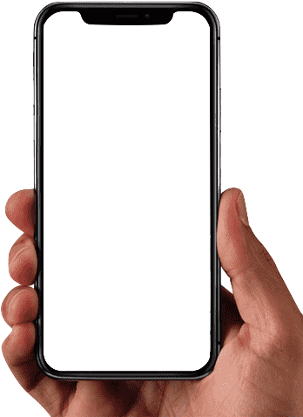




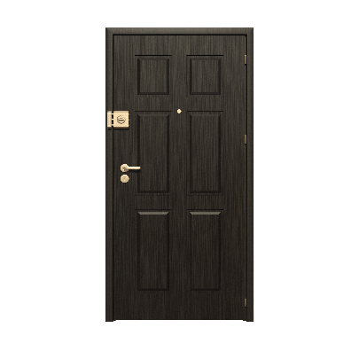
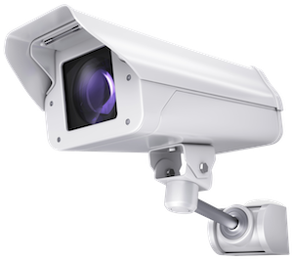




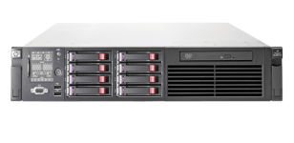





시스템 구성도
시스템 구성도
Button features added to:
- Highlight human detections at the frontdoor
- Allow users to download the human-detected images for user confirmation
HTTP/Restful API
PORT:8080
HTTP
button
Detects object at the front
door 24 hours a day
Change Detection
PORT:8000
HTTP
Frontdoor Detection
REST API
Image blog
<EDGE SYSTEM>
<SERVICE SYSTEM>
<CLIENT>
Image Processing Lab

Slide 5
목적
Frontdoor Detection aims to:
Alert users of any object detections at the frontdoor of the house
Alers users of possible human visitors detected
Protect user’s safety
Ensure user’s convenience at home
Image Processing Lab

Slide 6
필요성
With so many criminals and scammers with new tactics to trick people, it’s important to keep track on the people around our house. With this project, the users can detect the entities, objects or people, at their front door and keep track of the detections with the blog server. Users can be more aware of the objects and humans detected in front of their front doorstep and confirm if there is any danger aspects in the detected entities.
Image Processing Lab

Slide 7
기능 - 조건대비표
시스템 구분 | 세부기능 | 구현 여부 | 대체 여부 | 소스 파일명 (함수 또는 class명)
1. Edge System(Python 기반, 공통) | 1-1. YoloV5 pretrained model 사용(대체 가능) | O | X
 | 1-2. Ms coco 훈련데이터 기준 검출 객체 (Classes) : 80가지 객체 검출 기능(대체 가능 함) | O | X
 | 1-3. 한 종류의 객체를 동일한 객체로 가능한 Change Detection(대체 가능 함) | O | X
 | 1-4. 게시를 위한 HTTP Restfull API 사용(공통) | O | X
2. Service System(Python, Django 기반, Pythonanywhere 클라우드상 서비스 구동, 일부 확장 기능 가능) | 2-1. 사용자 보안 기능(보안키를 이용한 로그인, 공통) | O | X
 | 2-2. Image Blog 및 관리 기능(pythonanywhere.com 연결) | O | O
 | 2-3. 게시를 위한 HTTP Restfull API 제공(공통) | O | X
 | 2-4. Image 목록, 획득을 위한 HTTP Restfull API 제공 | O |  | Path: “/api/posts/”
 | 2-5. Android Person Filter API 제공 (추가 기능) | O |  | Path: “/api_person/posts/”
 | 2-6. Person Detection Filter (추가 기능) | O |  | Function post_list (edited with filter) in views.py
3. Client System(Android, Native App, 개별 제안) | 3.1. Image list view 기능(공통 기능, 개별 제안) | O | X | Function onClickDownload + Class CloadImage
 | 3.2. Image 목록, 획득을 위한 HTTP Restfull API 사용(신규 추가 필요) | O |  | Function onCLickImageListDownload + Class DownloadImagesTask
 | 3.3. Person Detection Filter | O |  | Function onFilterPerson + Class CloadImage
 | 3-4. Download Person-Detected Filters | O |  | Function onDownloadPerson + Class DownloadPersonImagesTask
Image Processing Lab

Slide 8
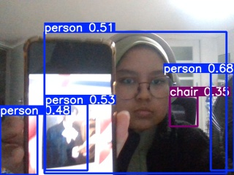
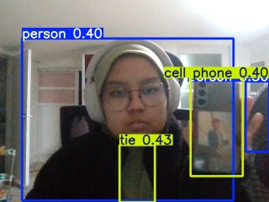
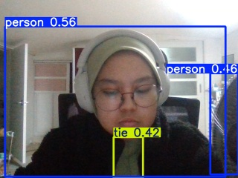
기능 - 1. Edge System(Python 기반, 공통)
1-1. YoloV5 pretrained model 사용 (대체 가능 함)
1-2. Ms coco 훈련데이터 기준 검출 객체 (Classes) : 80가지 객체 검출 기능(대체 가능 함)
Pretrained model is used as it is. However, there might be some
limitations with the detection
because the heater fan is also
detected as a person.
1-3. 한 종류의 객체를 동일한 객체로 가능한 Change Detection (대체 가능 함)
These pictures are taken 2 seconds away from each other. Even when a person is already detected, Change Detection detects the new person on the phone and a picture is captured because of it.

Slide 9
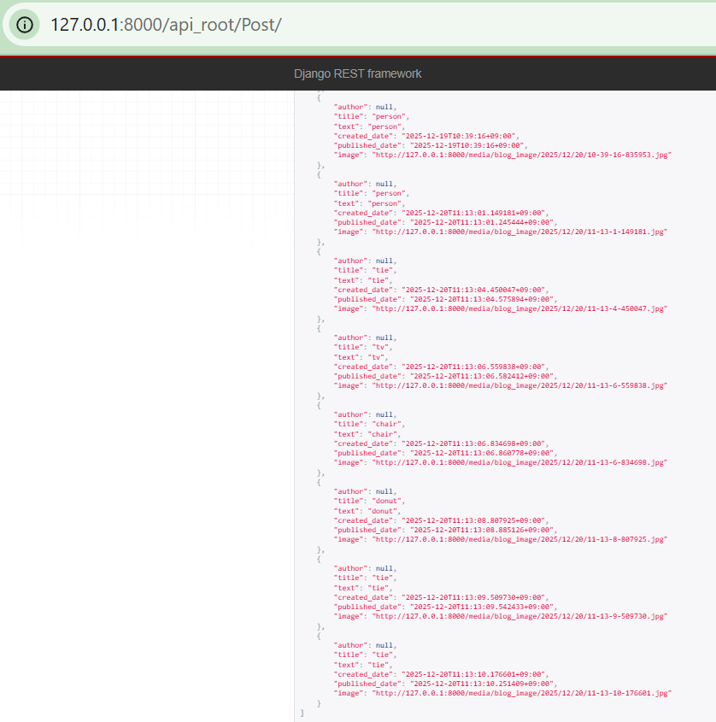
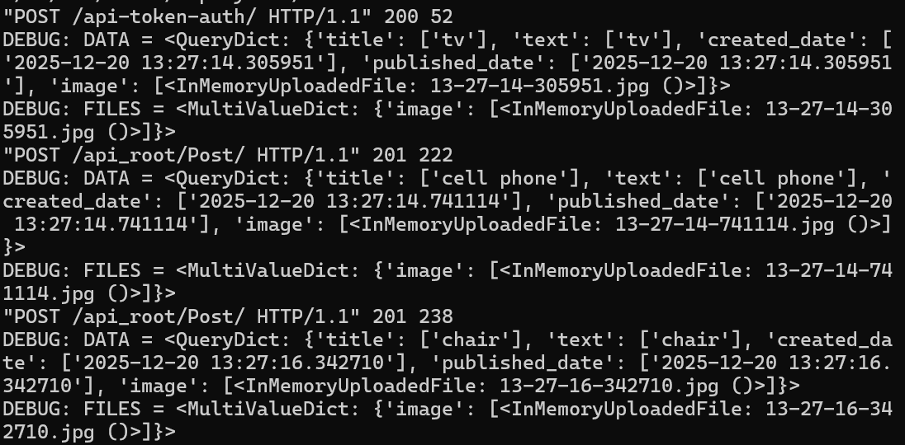
기능 - 1. Edge System(Python 기반, 공통)
1-4. 게시를 위한 HTTP Restful API 사용(공통)

Slide 10
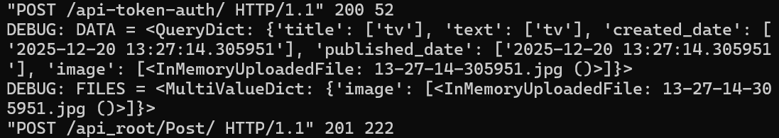
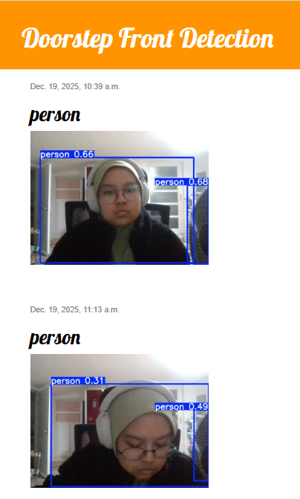
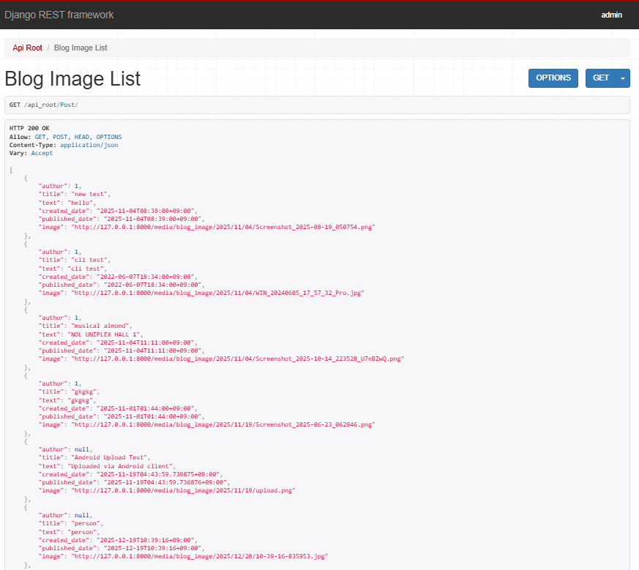
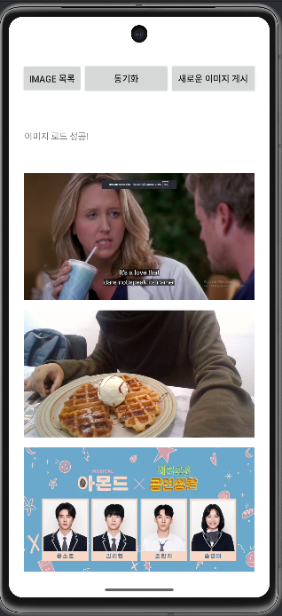
기능 - 2. Service System(Python, Django 기반)
2-1. 사용자 보안 기능(보안키를 이용한 로그인, 공통)
2-2. Image Blog 및 관리 기능(공통, 일부 확장 기능 가능)
2-3. 게시를 위한 HTTP Restful API 제공(공통)
2-4. Image 목록, 획득을 위한 HTTP Restfull API 제공(신규 추가 필요)

Slide 11
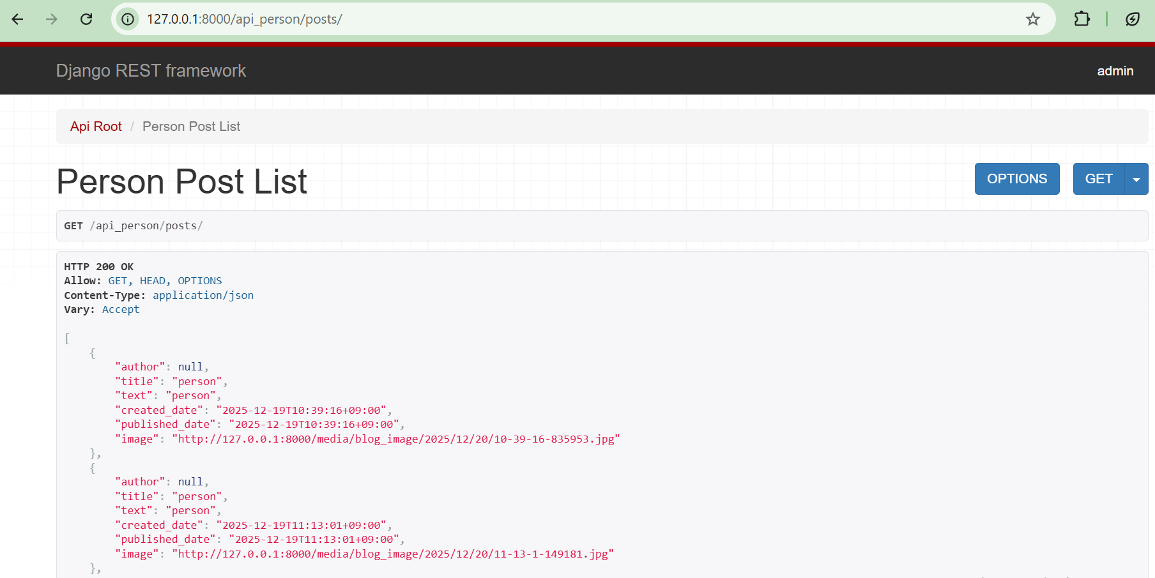
기능 - 2. Service System(Python, Django 기반)
2-5. API Endpoint from Django Server for Android App’s Person Detection Filter

Slide 12
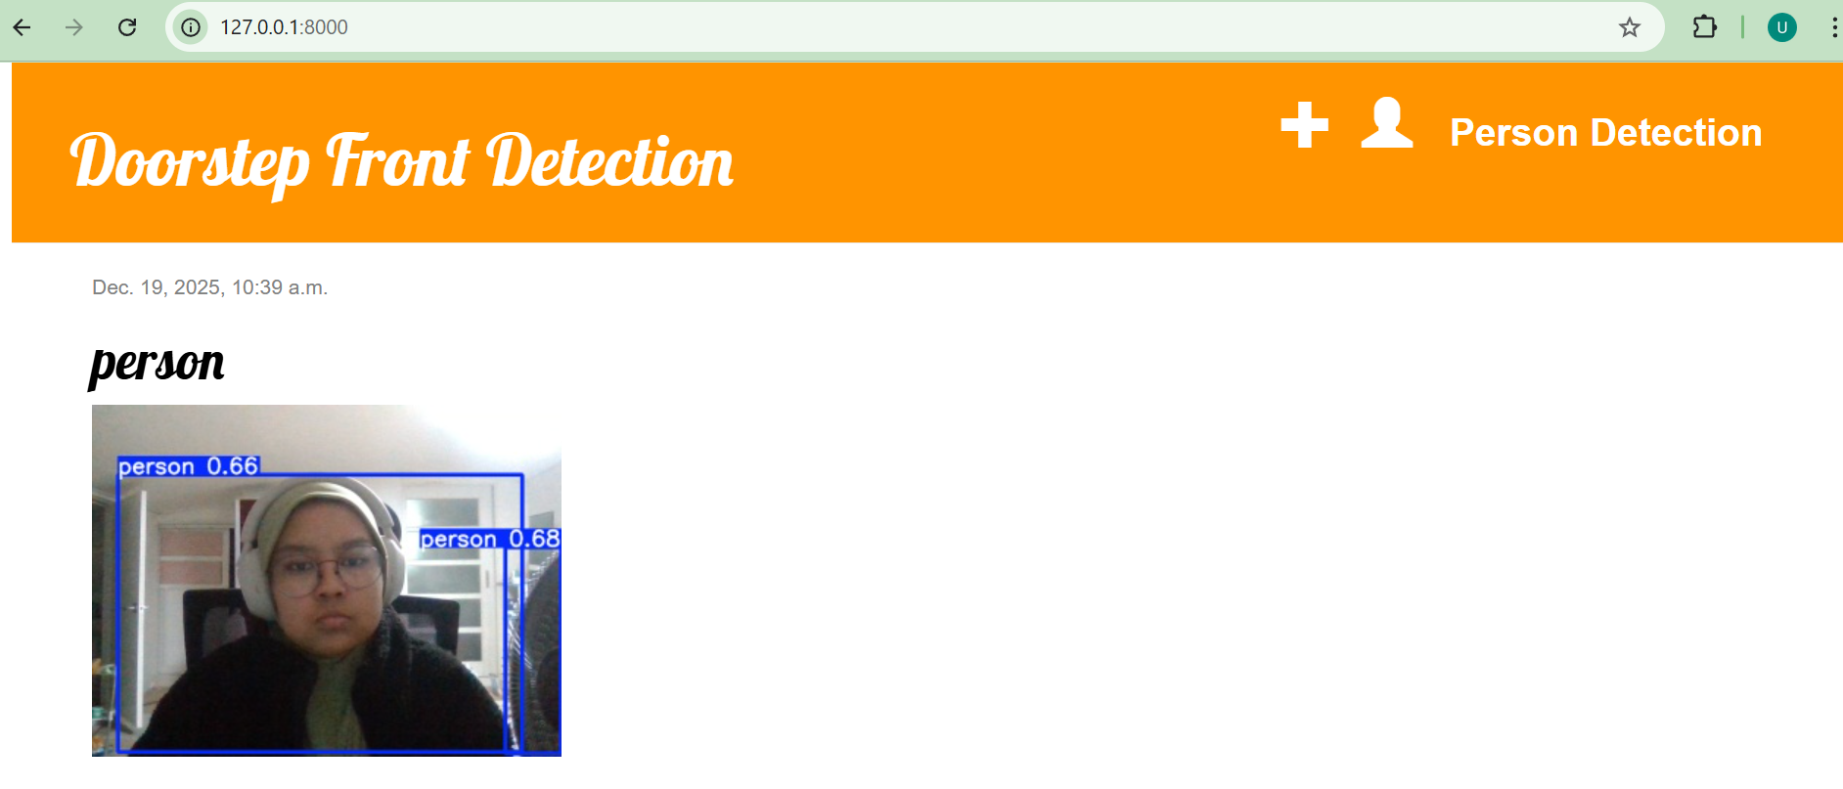
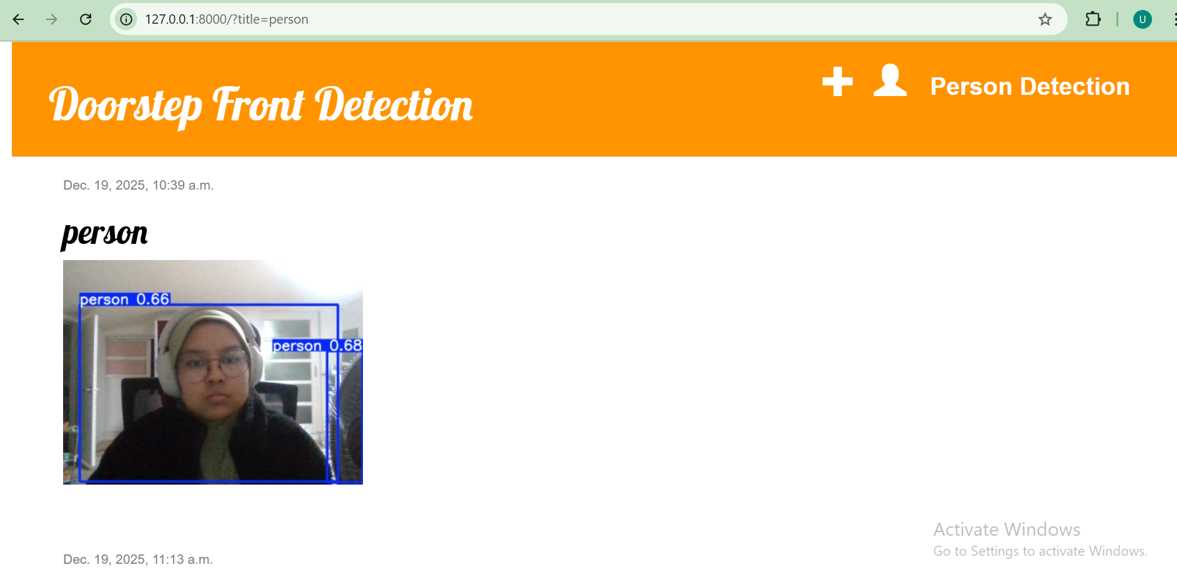
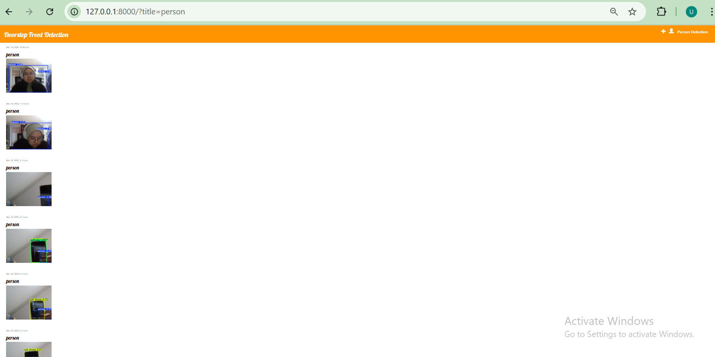
기능 - 2. Service System(Python, Django 기반)
2-6. Person Detection Filter
Click here
Yolo stores numerous posts into the system due to motions in real life. With this Person Detection Filter, user can skip the unimportant non-human posts, and focus on the person-detected filter
Only posts with title=“Person” is displayed. (posts which have high probability that there is actually a person)

Slide 13
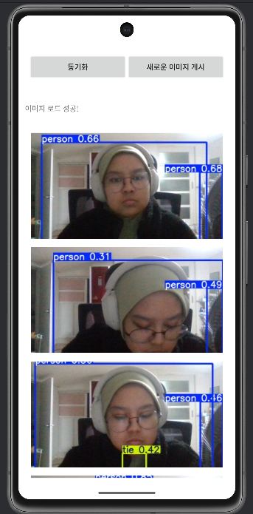
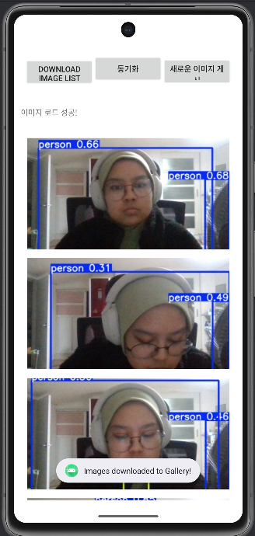
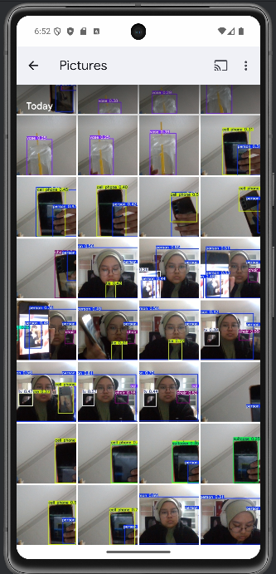
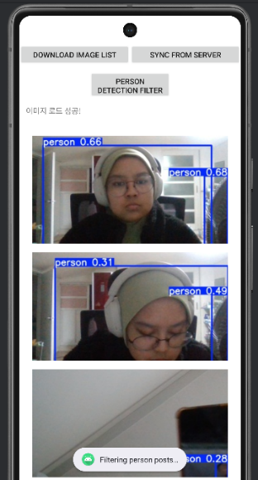
기능 - 3. Client System(Android, Java기반, 개별 제안)
3.1. Image list view 기능
3.2. Image 목록, 획득을 위한 HTTP Restful API 사용
3.3 Person Detection Filter (추가 기능)
User can filter and get the image list of posts where title=“Person” where it’s most probable that there’s a human detected in the picture
Downloaded Images saved in gallery

Slide 14
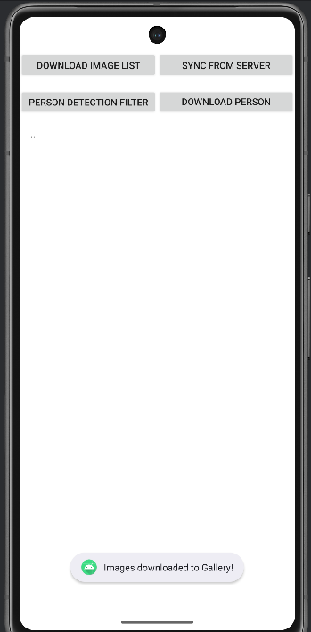
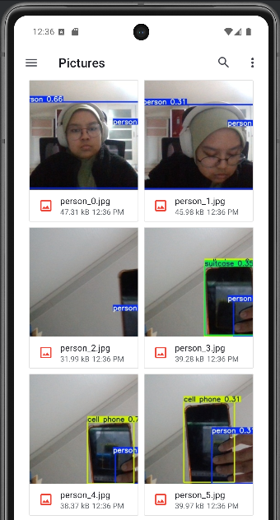
기능 - 3. Client System(Android, Java기반, 개별 제안)
3.4. Download Person-Detected Images Only (추가 기능)
Only person-detected images are downloaded

Slide 15
기능
Early Detection of Suspicious Entity/Danger
Entities are detected at the frontdoor automatically using YOLO
Automatic Storage of Entity Detection (Downloadable)
All entity detection will be saved as an image
All images are automatically kept into the server and can be seen in the website as a post (Django Server) and can be seen as raw images in the Android App
User can download all of the entity-detected images
Human Detection Filter
Filter button will filter out non-related posts so that only human-detected posts will be displayed in the page
Download Human-Detected Posts
User can download the posts titled as “Person” which are images with high probability that there’s a person in it
User can then go through the pictures more thoroughly to confirm if there’s any danger
Image Processing Lab

Slide 16
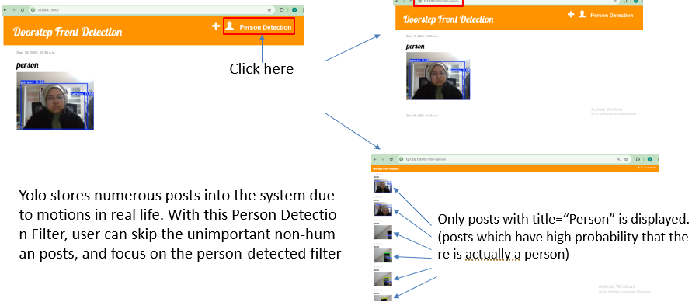
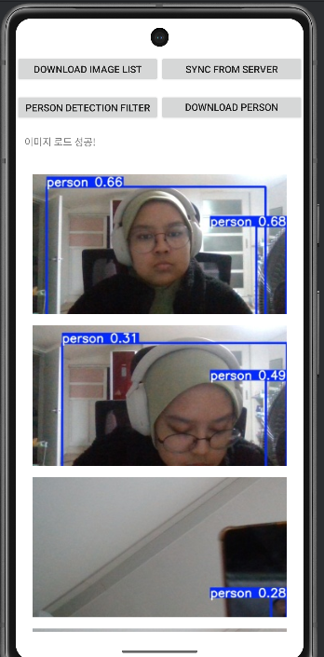
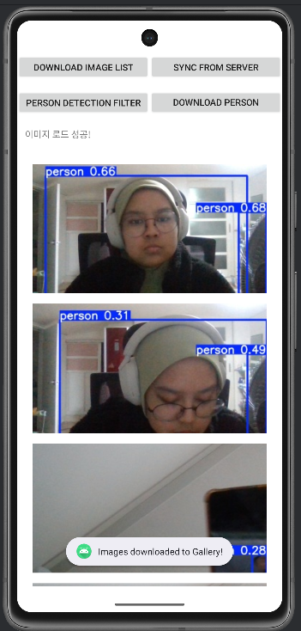

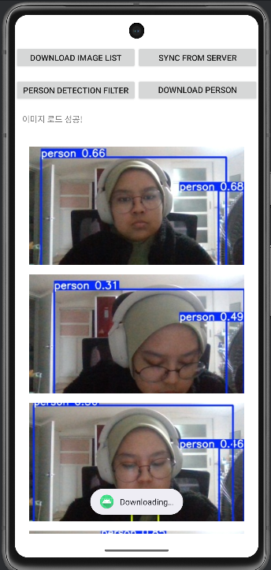
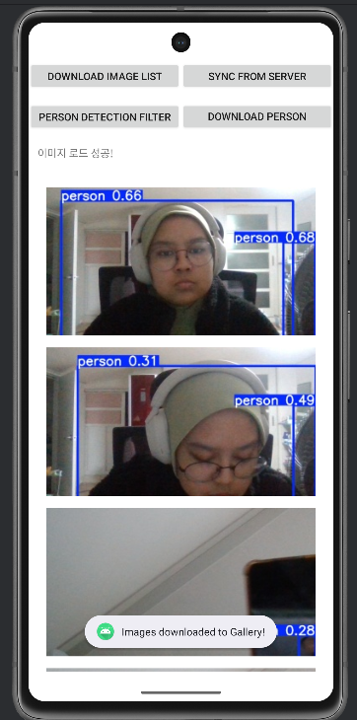
사용자 시나리오(Ui 구성)
All entity detection are stored as images in the Django Server. Users can filter posts so that only person-detected will be displayed.
Entity detection at frontdoor
Images from Django Server can be synced into the Android App. Users can download the pictures, to help with any investication in case of danger detection.
Image Processing Lab

Slide 17
데모 동영상
Frontdoor Detection Project Demonstration & Voice-over Explanation: https://drive.google.com/file/d/1Kpv7lLraATzH_opSUeLtGhuq4YtDl_hx/view?usp=sharing

Slide 18
기대효과 및 결론
Increased User Safety and Convenience
With this project safety system applied on houses, user’s safety can be guaranteed and this would help in increasing user’s confidence and convenience towards their home and its safety
Surrounding Awareness
More people will be more aware of possible dangers around their house without dismissing any exception towards friends or close ones with the help of a non-biased entity detection.
Criminals Identification
Criminals can be identified even after the crime has happened using the pictures kept in advance in the server
Image Processing Lab

Slide 19
결과물의 목록
서비스 URL : http://127.0.0.1:8000/ OR umairayusra.pythonanywhere.com
소스코드 git 주소 : https://github.com/mountainchwe/MobileWebFinalProj
Root
Edge_System
YOLO
Service_System
Django
Client_System
Android, Native App
FinalTerm 보고서.pptx
url.txt (서비스 URL, 소스코드 git 주소)
Image Processing Lab

